Slide 1
DNS usage in LoRaWAN
Oct. 2018
Notes:
PAN uses – IoT Blue tooth, Zigbee etc..
Wireless sensor Networks such as 6LoWPAN

Slide 2
Overview
Afnic’s past IoT activities
Introduction to the LoRa infrastructure
DNS present and possible future usages in LoRaWAN
Notes:
Afnic’s work on IoT

Slide 3
Afnic’s past IoT activities

Slide 4
Examples of SDOs and respective naming services
Identification Schema | SDO | Naming Service
URI (e.g. Domain names) | IETF | DNS
EPC | GS1 | ONS
OID | ITU and ISO/IEC | ORS
DOI | ISO | Handle
Notes:
OID Uses :
Known areas of use include:
Extensive use in security in IETF, Rec. ITU-T X.500, ISO/IEC, RSA and NIST encryption algorithms, etc.;
extensive use in e-health standards;
extensive use for network management (Management Information Bases, MIBS);
use related to RFID tags;
emerging use for the Common Alerting Protocol for disaster notification:
use for cybersecurity alerts.
https://www.doi.org/factsheets/DOIHandle.html

Slide 5
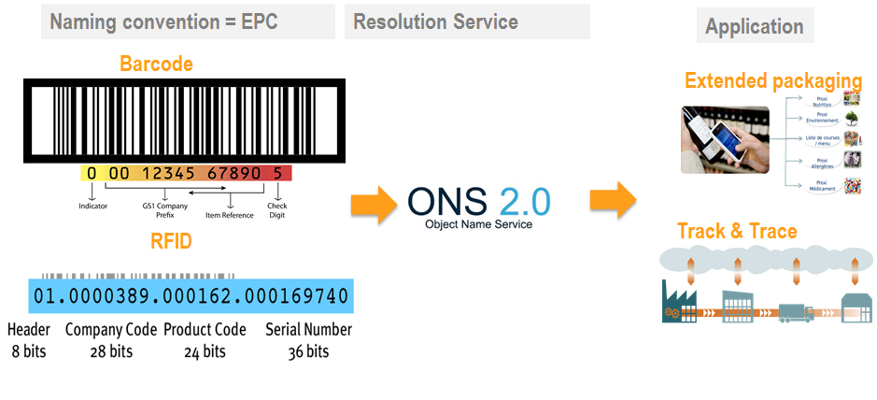
DNS in the bar code/RF-ID domain

Slide 6
LoRa introduction

Slide 7
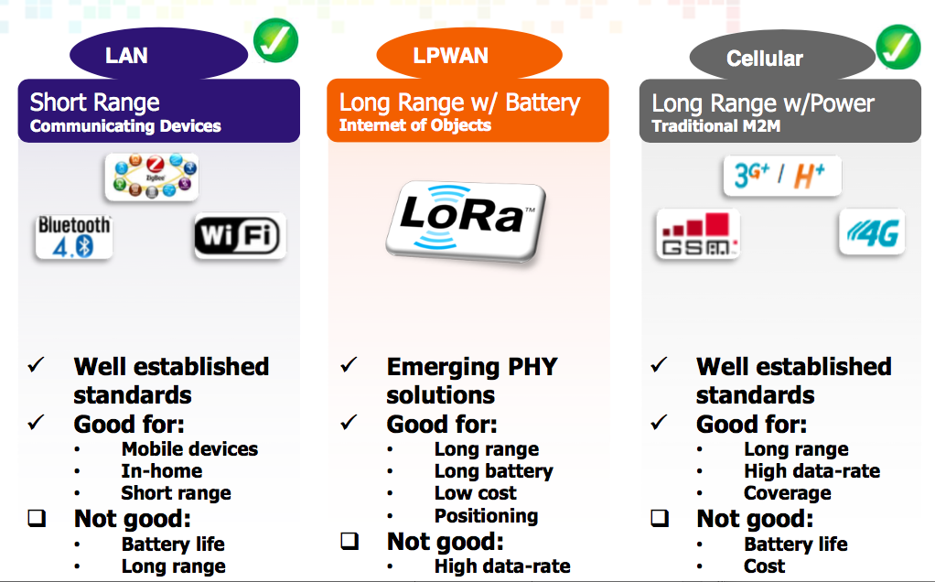
IoT segment trade-offs
Source : Semtech
Notes:
Rat catching in Warehouses

Slide 8
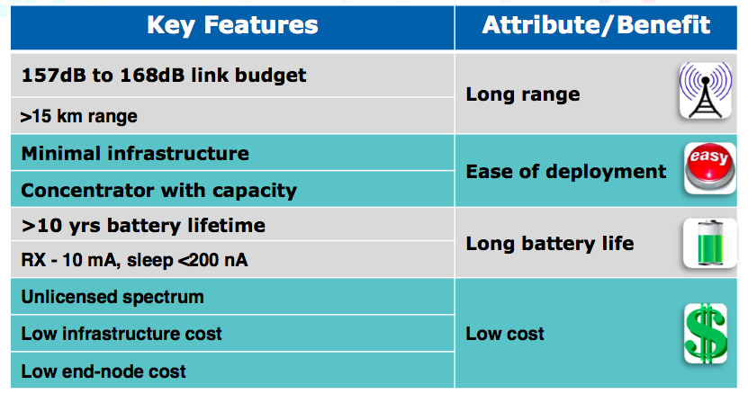
LoRa network advantages
Source : Semtech

Slide 9
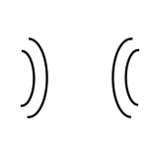
LoRa network topology
End-devices
Gateways
Network Server
Application/Join
Server
Sub-GHz RF
IP
IP
Notes:
Need for each servers

Slide 10
Why LoRa-alliance chose DNS?
A scalable model
Notes:
Unlike telephony, there could be number of networks.

Slide 11
DNS usage in LoRaWAN Specs
OTA activation
Roaming – either passive or handover roaming
Notes:
Activation by personalization (ABP)

Slide 12
Pre-provisioning needed before OTAA
Device contains the
DevEUI, NwkKey, AppKey, JoinEUI
Network server contains the
DevEUI, NwkKey
Appserver contains the
DevEUI, AppKey
Notes:
ABP – Activation

Slide 13
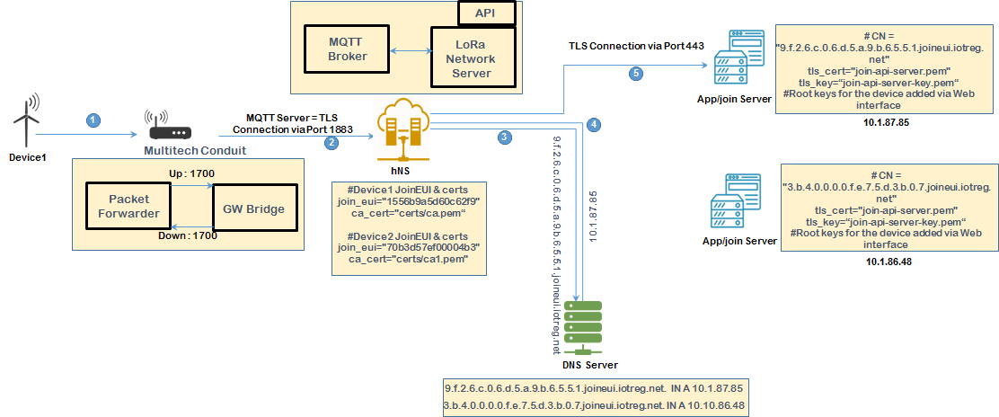
OTAA via DNS for device ‘1’

Slide 14
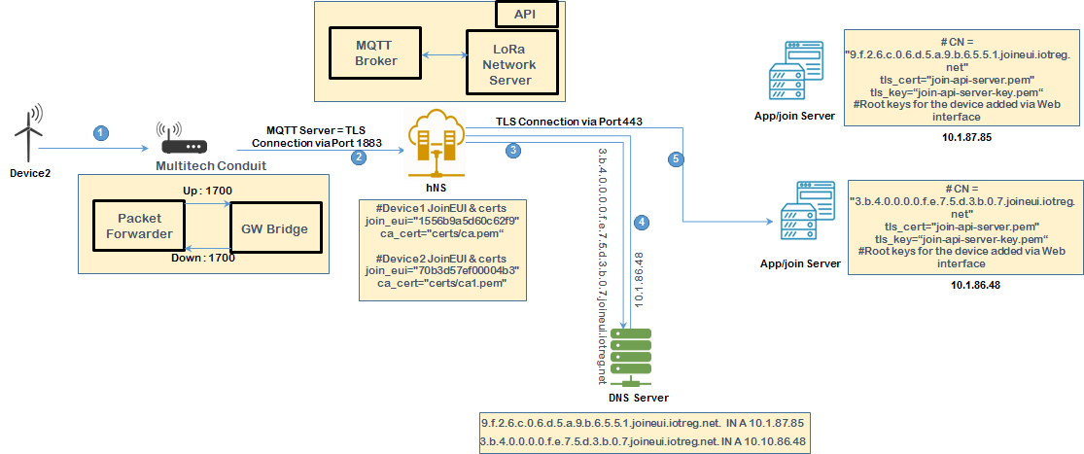
OTAA via DNS for device ‘2’

Slide 15
Information in the device after OTAA
Device contains the
DevEUI, NwkKey, AppKey, JoinEUI, JoinNonce, NetID, DevAddr , NwkSIntKeyUp, NwkSIntKeyDwn, NwkSEncKey, AppSKey
Notes:
Uplink Frame contains NwkID, which is derived from the NetID
The NetID is obtained from the LoRa alliance. For roaming, this identifier is needed.

Slide 16
Passive roaming scenario using DNS
Operator ‘A’ rests as the sNS
for the device and maintains
the connection between the
JS and the AS
Operator ‘B’ becomes the fNS
for the device by forwarding
packets from/to the device
fNs
hNs
DNS
Packet uplink
Uplink destined for
Operator ‘A’
Packet uplink
But, the GW forwards
the “packet” to Operator ‘B’
Get IP address of the Operator ‘A’
IP address of the Operator ‘A’
Packet uplink
Packet downlink
Packet downlink
Packet downlink

Slide 17
LoRa DNS tree
delegation
.
Zone “.”
Zone “net”
Zone “org”
org
net
Zone “lorawan.net”
Zone “lora-alliance.org”
lora-alliance
lorawan
Zone “netids.lorawan.net”
Zone “joineuis.lorawan.net”
netids
joineuis

Slide 18
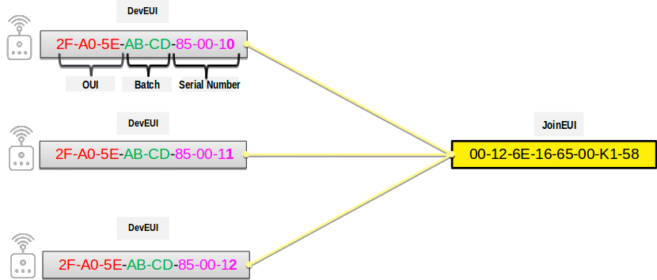
Solving device manufacturer issue using DNS

Slide 19
Breaking the JoinEUI dependancy
*.D.C.B.A.E.5.0.A.F.2.8.5.1.K.0.0.5.6.6.1.E.6.2.1.0.0.joineui.lora-alliance.org. IN A 1.2.3.4
DevEUI reversed
until the batch number
JoinEUI reversed
Breaking the JoinEUI dependancy of the JS:
*.4.5.D.C.B.A.E.5.0.A.F.2.8.5.1.K.0.0.5.6.6.1.E.6.2.1.0.0.joineui.lora-alliance.org. IN A 1.1.1.1

Slide 20
To use IP or not in IoT
IoT is about connecting « things » to the Internet
Non IP devices connect to the Internet through an Internet gateway
The gateway is an application layer gateway – Needs to strip the data and restructure it with a TCP/IP stack in order to enable communication with an Internet service
Packets encrypted at the IoT network must be decrypted and re-secured in the IP datagram at the Internet gateway
IP based IoT devices can route and forward data without much intervention

Slide 21
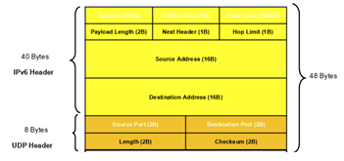
Issue - IPv6/UDP Header Size
IPv6/UDP
6LoWPAN
Compression Residue + Rule ID
< 1 bytes
SCHC

Slide 22
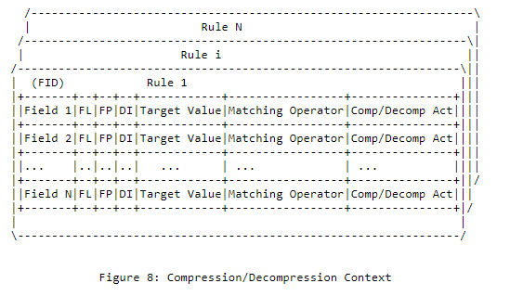
SCHC Context

Slide 23
Resolving the context from the DNS
hNs
DNS
Join Request
LoRa Packet with SCHC compression residue + Rule ID
Join Request
The GW forwards
the “packet” to hNs
Get the context to decompress the packet based on the rule ID and the Device Unique Identifier
Context for decompressing the packet

Slide 24
Issue : Shared Secret Key need to be pre-provisioned manually
Device contains the
DevEUI, NwkKey, AppKey, JoinEUI
Network server contains the
DevEUI, NwkKey
App/Join server contains the
DevEUI, AppKey

Slide 25
Key distribution Challenges
Device manufacturer adds the Key in the device
Keys are shared with device owner:
Written in the back of the device
By files, mails etc..
The Keys then have to be shared with the Network Operator, Join Server operator, App server operator

Slide 26
Looking at : DNSSEC, DANE, DoT
DNS as PKI
Manufacturer
Network Server
App Server

